Slide 1

Business Problem
Currently the policy addition process is manual and hence prone to human errors and time consuming
It does not have the ability to self heal if any deviations in the existing environment
There is no monitoring and alerting mechanism that can help identify the current state of the environment
Interaction between different environments(GHEC and Prisma) is manual
Standardized approach to manage policies

Slide 2




Prisma DevOps Pipeline – Salient Features
Seamless integration between GitHub Enterprise Cloud, Azure and Prisma Cloud
Zero touch deployment of Prisma Cloud Policy framework
Extensive logging to facilitate debugging in case of issues
Effective monitoring by sending log file via email along with the final deployment status
Email notifications
GitHub
Azure
Prisma Cloud

Slide 3




Prisma DevOps Pipeline - Standardization
Custom Policy Standard – Optum Connect Cloud
All polices have been grouped together in a custom policy standard which helps in better management and reporting
Self heal capability
The script automatically recreates any new/missing policy in the environment
Security Consideration
All sensitive information has been encrypted in the scripts and masked in the log files
API Driven
The script is developed using Python and is completely driven by Prisma and GitHub APIs
Email notifications
GitHub
Azure
Prisma Cloud

Slide 4
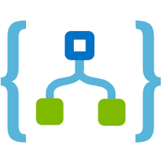


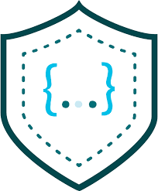


Prisma DevOps Pipeline - Deep Dive
Email trigger with final status and Log file
7
Log file retrieved
Email notifications
Scheduled Logic App
6
5
Trigger
Log file saved to storage
Azure Storage Blob
1
4
Policies pushed to Prisma cloud
3
Retrieved Policy
API Calls
2
Automation Account Runbook
Prisma Policies Repository
GitHub and Prisma Restful APIs
Prisma Cloud

